Slide 1


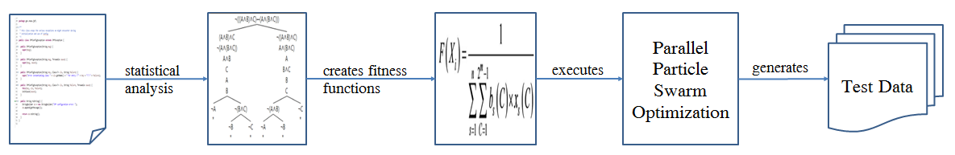
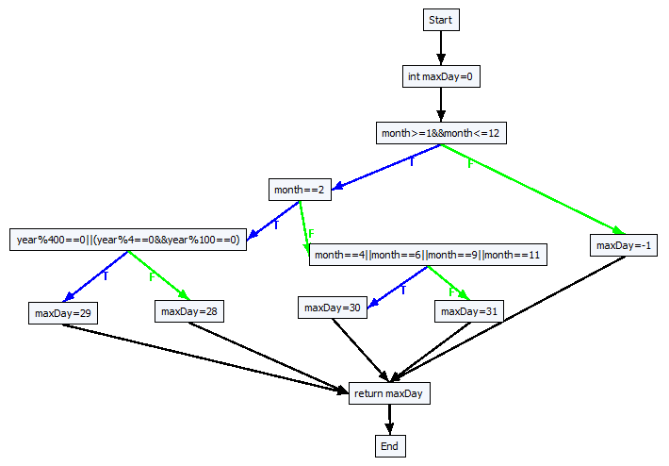
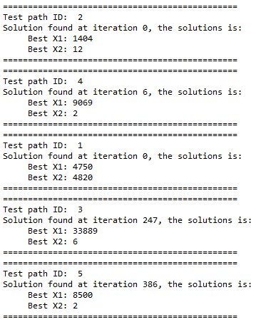

PhD Student Scientific Workshop
Generating Test Data for Software Structural Testing using
Parallel Particle Swarm Optimization
Dinh Ngoc Thi, Vo Dinh Hieu, Nguyen Viet Ha
Abstract
Evolutionary structural testing is an approach to automatically generating test cases that achieve high structural code coverage. In recent investigations particle swarm optimization
(PSO), an alternative search technique, often outperformed other meta-heuristic search techniques when applied to various problems. This paper proposes the approach of
combination of static analysis program and Parallel Particle Swarm Optimization (PPSO) in order to generate test data simultaneously for each test path of the given program
under test (PUT). The proposed approach is also applied to some PUTs of the given benchmark. Experimental results demonstrate that the proposed PPSO can automatically
generate suitable test data has higher structural code coverage than the previous one.
Introduction
Proprosed approach
In recent years, meta-heuristic search techniques has been widely applied in software testing,
forming a research trend called search-based software testing, which is especially applied to
automatic test data generation. Among the existing meta-heuristic search techniques, such as
simulated annealing (SA) and generic algorithm (GA), are the most popular algorithms, and
have been widely adopted in generating test data. However even though they can generate test
data with appropriate fault-prone ability, they fail to produce them quickly due to their slow
evolutionary speed. Recently, as a swarm intelligence technique, particle swarm optimization
(PSO) has become a hot research topic in the area of intelligent computing. Its significant
feature is the simplicity and fast convergence speed. Even so, there are still certain limitations
in current research on PSO usage in test data generation. For example, consider one program
under test which was used in Mao’s paper [9] as below:
Regarding this program under test, Mao’ paper used PSO to generate test data through building
the one and only fitness function which was the combination of Korel formula [10] and the
branch weights. This proposal has two weaknesses: the branch weight function being entirely
performed manually and some PUTs not being able to generate test data to cover all test paths.
To overcome these weaknesses, we still use PSO to generate test data for the given PUT.
However, unlike Mao, our approach is to assign one fitness function for each test path. Then we
will use PPSO to find simultaneously the solution corresponding to this fitness function, which
is also the one being able to generate test data for this test path.
Step 1: Generate control flow graph(CFG) from the program under test(PUT)
int getDayNum(int year, int month) {
int maxDay=0;
if(month≥1 && month≤12) {
if(month=2) {
if(year%400=0||(year%4=0&&year%100=0))
//bch3: branch 3
maxDay=29; // path 5
else //bch4: branch 4
maxDay=28; // path 4
}
else if(month=4||month=6||month=9||month=11)
//bch5: branch 5
maxDay=30; // path 3
else //bch6: branch 6
maxDay=31; // path 2
}
else //bch7: branch 7
maxDay=-1; // path 1
return maxDay;
}
Step 2: Generate all test paths from the CFG
No | PathID | Path’s decision nodes
1 | path1 | [(month ≥ 1 && month ≤ 12), T], [(month = 2), T], [(year % 400 = 0 | | (year % 4 = 0 && year % 100 = 0)), T]
2 | path2 | [(month ≥ 1 && month ≤ 12), T], [(month = 2), T], [(year % 400 = 0 || (year % 4 = 0 && year % 100 = 0)), F]
3 | path3 | [(month ≥ 1 && month ≤ 12), T], [(month = 2), F], [(month = 4|| month = 6|| month = 9 || month = 11), T]
4 | path4 | [(month ≥ 1 && month ≤ 12), T], [(month =2), F], [(month = 4|| month = 6|| month = 9 || month =11), F]
5 | path5 | [(month ≥ 1 && month ≤ 12), F]
Step 3: Base on Korel formula, generate fitness function f_{i} for each decision node
No | Decision node | Fitness function | ID
1 | [(month ≥ 1 && month ≤ 12), T] | fBchDist(month, ≥, 1) + fBchDist (month, ≤, 12) | f₁T
2 | [(month ≥ 1 && month ≥ 12), F] | min(fBchDist (month, <, 1), fBchDist (month, >, 12)) | f₁F
3 | [(month = 2), T] | fBchDist (month, =, 2) | f₂T
4 | [(month = 2), F] | fBchDist (month, ≠, 2) | f₂F
5 | [(year % 400 = 0 || (year % 4 = 0 && year % 100 = 0)), T] | min(fBchDist (year %400, =, 0), (fBchDist (year %4, =, 0) + fBchDist (year %100, =, 0))) | f₃T
6 | [(year %400 = 0 || (year % 4 = 0 && year % 100 = 0)), F] | fBchDist (year %400, ≠, 0) + min(fBchDist (year %4, ≠, 0), fBchDist (year %100, ≠, 0)) | f₃F
7 | [(month = 4 || month = 6 || month = 9 || month = 11), T] | min(fBchDist (month, =, 4), fBchDist (month, =, 6), fBchDist (month, =, 9), fBchDist (month, =, 11)) | f₄T
8 | [(month = 4 || month = 6 || month = 9 || month = 11), F] | fBchDist (month, ≠, 4) + fBchDist (month, ≠, 6) + fBchDist (month, ≠, 9) + fBchDist (month, ≠, 11) | f₄F
Step 4: Generate fitness function F_{j} for each test path by summary all fitness function in each decision node
No | PathID | Test path fitness functions
1 | path1 | F₁ = f₁T + f₂T + f₃T
2 | path2 | F₂ = f1T + f2T + f3F
3 | path3 | F₃ = f1T + f2F + f4T
4 | path4 | F₄ = f1T + f2F + f4F
5 | path5 | F₅ = f1F
★Result: all test paths were covered by generated test data
Step 5: Using Particle Swarm Optimization (PPSO) for each fitness function F_{j,} then execute them in parallel
Algorithm: Parallel Particle Swarm Optimization(PPSO)
Input: list of fitness function
Output: test data for each fitness function
1: for each fitness function F_{j} 2: Initialize an object pso of class PSOProcess
3: Assign a fitness function F_{j} to object pso
4: Execute object pso: pso.start();
5: end for
Experimental Results
Conclusions
1. Automatic ability
As there is no need to build the branch weight function, the automatic feature of this proposal will be improved.
The fitness functions are automatically built basing on the decision nodes of each test path, and those decision nodes can be entirely
generated automatically from a PUT with above mentioned step 2 and 3. This obviously advanced the automatic ability in our proposal.
2. Coverage ability
The two criteria to be compared with Mao’s result are:
Success rate (SR): the probability of all branches which can be covered by the generated test data.
$$SR=\frac{the number of all branches were covered by generated test data}{1000}$$
Average coverage (AC): the average of the branch coverage achieved by all test inputs in 1,000 runs.
$$AC=\frac{\sum{coverage for each run}}{1000}$$
We also confirmed our proposed approach on the benchmark which is used in Mao’s paper.
The detail results of the comparison with PUT benchmark used by Mao in 2 criteria are shown in the following table:
This paper has introduced and evaluated
a parallel PSO approach for the branch
coverage test adequacy criterion of
software testing. We propose to assign a
fitness function of PSO for each test path
of a PUT, and then execute those PSOs
simultaneously in order to generate test
data to cover test paths of a PUT. The
experimental result proves that our
proposal is more effective than other
current test data generation methods using
PSO in terms of both automatic and
coverage ability for a PUT.
In future work, some issues should be
incorporated into deep investigation. The
search capability of PSO algorithm could
be enhanced through absorbing some
other strategies in intelligent computing.
To exploit more reasonable form of
fitness function is also a valuable research
topic. At present, we only display the
results of some benchmark programs
from academe. So the experiments on
some industrial programs are worthy
of being deeply studied.
PUT name | Lines of code | Branches | Arguments | Description
triangleType | 31 | 5 | 3 | Type classification for a triangle
computeTax | 61 | 11 | 2 | Compute the federal personal income tax
printCalendar | 187 | 33 | 2 | Print the calendar of a month in some year
line | 92 | 36 | 8 | Check if two rectangles overlap
Program under test | Success rate (%) |  | Average coverage (%)
 | Mao’s PSO | PPSO | Mao’s PSO | PPSO
triangleType | 99.80 | 100.0 | 99.94 | 100.0
computeTax | 99.80 | 100.0 | 99.98 | 100.0
printCalendar | 99.10 | 100.0 | 99.72 | 100.0
line | 99.20 | 100.0 | 99.86 | 100.0
Advisor: Assoc. Prof. Nguyen Viet Ha, Dr. Vo Dinh Hieu

